Slide 1
TIDE Rosters 3-5
Charlie Henderson – Data Specialist I
Evaluation Services
Notes:
I’ve got some info on TIDE rosters to share with you. And while I’ll be going into some detail, I don’t expect you to be rostering experts when you leave. Think of this as a quick tour through rosters that you can reference back to when you need to find to the actual manual. This is only for 3-5. k-2 in Renaissance place will still appear.

Slide 2
Agenda
Rostering…
Overview
What? Why? Who? Where? When?
Data
Bulk uploading
Manually creating, editing, and viewing
Prior year data
Full info in the TIDE User Guide https://flfast.org/teachers.html
or https://www.escambiaschools.org/eval.
Notes:
who what where when why -> what why who where when
What data is used.
Bulk uploading rosters Manually creating, using, and editing are lumped together because the same screens are used to access the rosters. It’s just the end result that slightly varies.
And lastly, viewing data from previous years.

Slide 3
What are rosters?
Named groups of students linked to a specific individual in the Test Information and Distribution Engine (TIDE)
Can be linked to:
Test Administrator (TA)
teachers
media specialists
counselors (may be TA but probably SAC)
School Assessment Coordinators (SAC)
Notes:
Again, out of order, but I want to tell you what we’re dealing with before going into more detail.

Slide 4
Why are rosters used?
Rosters organize students to facilitate two main functions:
To view test scores in Florida Reporting System (FRS)
Teachers
Admin
Curriculum Coordinators
To print test tickets for testing groups via TIDE
Admin
SAC

Slide 5
Who is involved with rosters?
Creating and Editing
Contained within rosters
Evaluation Services
SAC
Teachers
TAs
SACs
Students

Slide 6
Where are rosters connected?
Focus
FRS
TIDE
Data is not automatically uploaded from Focus into TIDE
Rosters are the only link between teachers and students
Upload, create, and edit rosters
View test scores by school, grade, or roster
Not grouped automatically by teacher
Upload, create, and edit rosters
Organize testing groups
Print test tickets
Notes:
This is only for 3-5. k-2 in Renaissance place will still appear.

Slide 7
When are rosters updated?
Evaluation Services
Schools (SACs)
Before each PM window
Periodically throughout the year
New students*
New teachers/TAs
Need additional groups for test tickets
*Only for out of state or district students. SACs should contact Heather if a student transfers within the district.

Slide 8
Data Used in TIDE
Students
Teachers
FLEID
Demographics
School
Can only be at one school and district
Grade
Accommodations
Planned assessments
Email address
Used as login name
Name
School
Can be at multiple schools
Role/Level of access
Notes:
Planned assessment – above grade testing, retake status, EOCs, etc.

Slide 9
Data Restrictions in TIDE
Students
Both
Teachers
Can only be at one school and district
Removed from current location in TIDE if added to a new one
Can be on multiple rosters
Not tied to Focus
Must be added to TIDE manually
In bulk or individually
By Eval Services or SAC
Can be at multiple schools
Can have multiple rosters

Slide 10
Roster Creation and Modification
Bulk
Both
Manual
Multiple rosters created or modified with one upload
Template required
Student FLEID required
Not instant
Create new roster
Modify existing roster
Can be done by Eval Services or SAC
One roster at a time
Students can be added or removed by name
Displays students already on roster
*Less error prone since everything is manually selected

Slide 11
Rosters Created by Eval Services*
Primary Schools
Secondary Schools
One TIDE roster per homeroom
Primary roster names are the teacher’s username
E.g. CHenderson2
One TIDE roster per period
Secondary roster name format is “##-username”
## = period number or HR
E.g. 01-CHenderson2
*SACs can use their own naming format and inclusion rules for rosters they create.

Slide 12
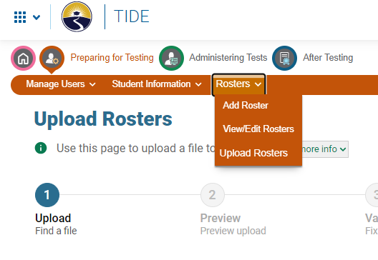
Roster Modifications - TIDE
Bulk upload, manual creation, editing, and/or viewing
OR

Slide 13
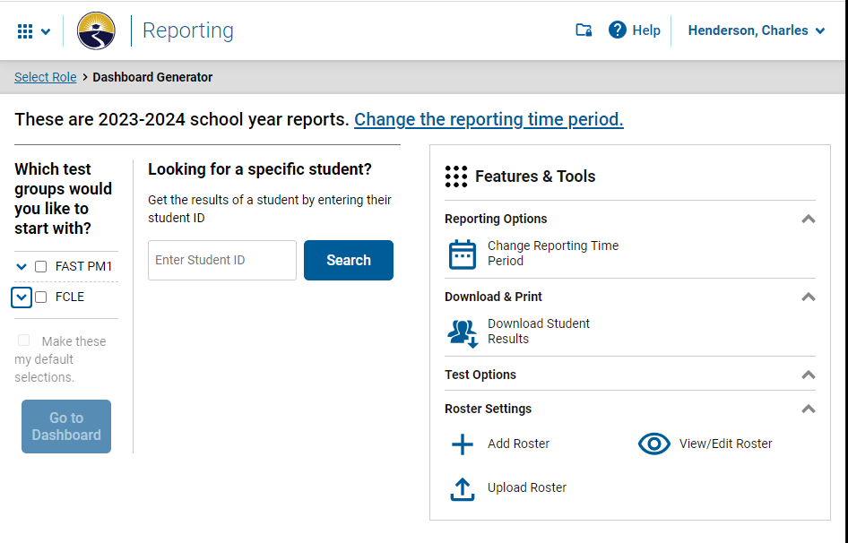
Roster Modifications - FRS
Bulk upload, manual creation, editing, and/or viewing

Slide 14
Uploading Rosters
Recommended: In TIDE only, you can click “Help” for detailed instructions and examples.
1. Download and populate the template.
2. Upload the populated template.
3. Click “Next”.

Slide 15
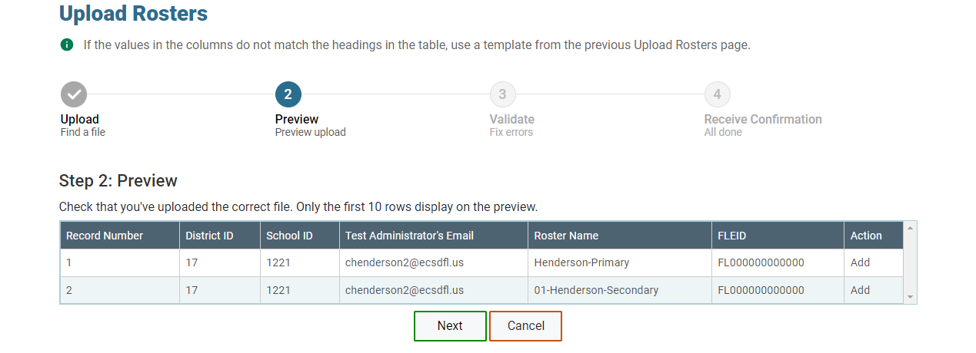
Previewing Uploads

Slide 16
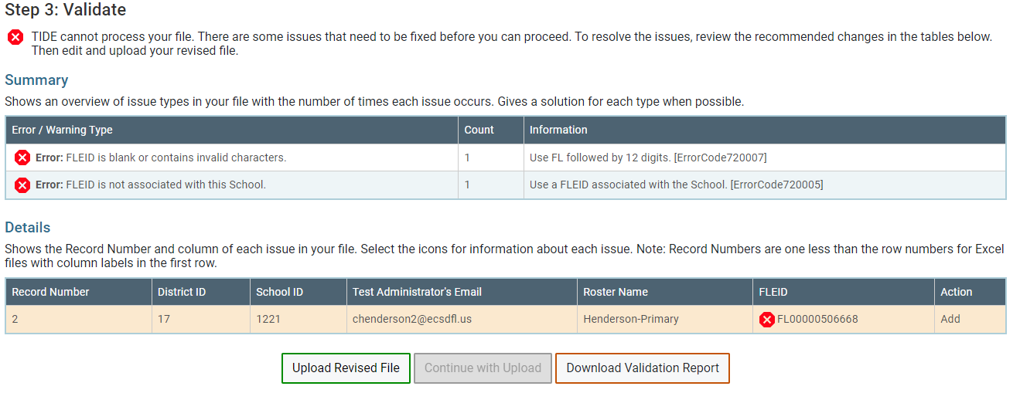
Validating Uploads…
If things don’t go smoothly
Fix and reupload a revised file
OR
“Continue with Upload” if few enough errors

Slide 17
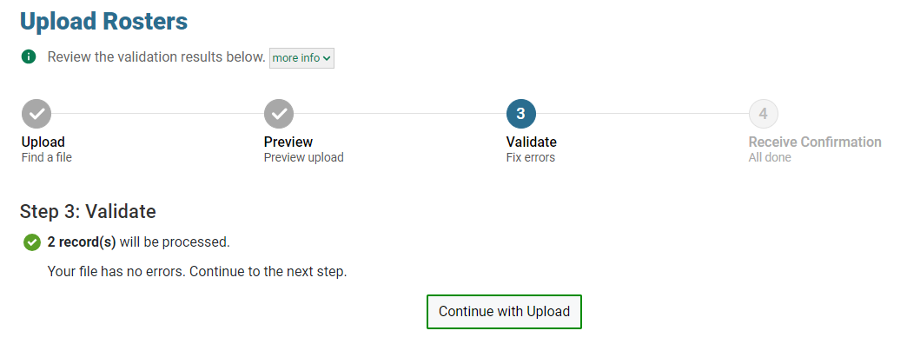
Validating Uploads…
If things do go smoothly

Slide 18
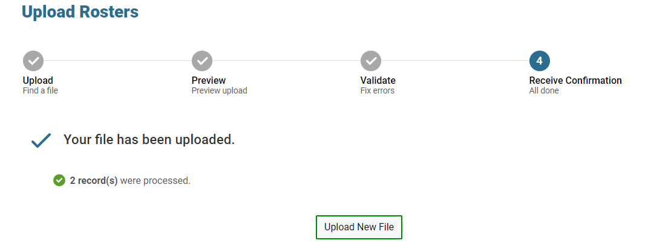
Validating Uploads…
If things do go smoothly

Slide 19
Validating Uploads…
If things do go smoothly
Check History for validation and rejected records report.

Slide 20
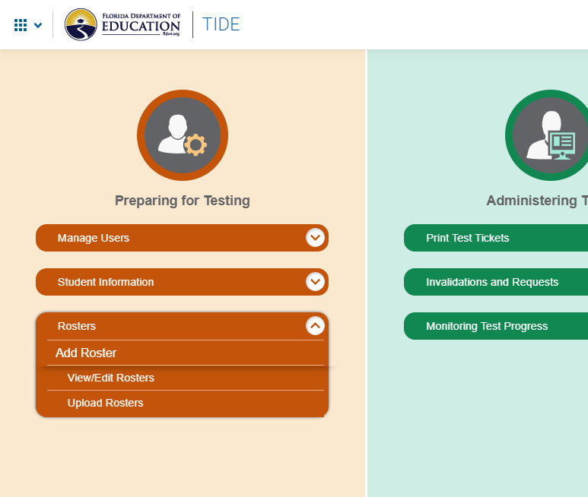
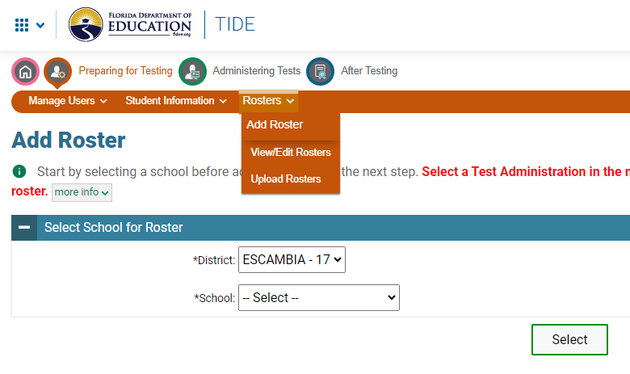
Creating, Editing, & Viewing - TIDE
OR

Slide 21
Creating, Editing, & Viewing - FRS

Slide 22
Finding or Creating Rosters
Recommended: Click “Help” for detailed instructions and examples.
Use the same process for both
Edit only: Optionally, limit the search by selecting a teacher.
1. Select your school.
2. Click “Select” or “Search”.
3. Click “View Results” on the next page when Editing rosters.

Slide 23
Viewing Rosters
Select the roster(s) to view, then click the printer dropdown.

Slide 24
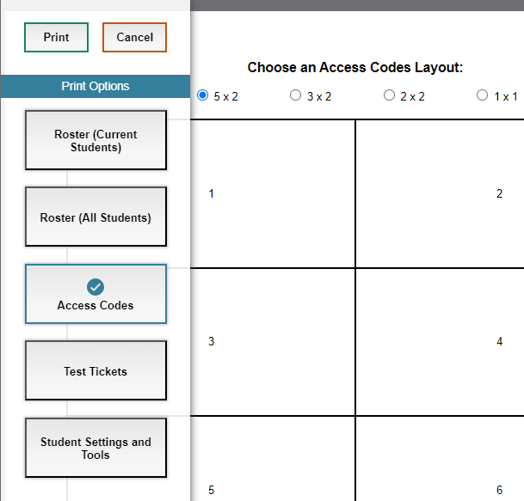
Viewing Rosters
Pick any option to get a new screen with the same options.
Student accommodations

Slide 25
Downloading Rosters
Select the roster(s) to view, then click the download dropdown.

Slide 26
Downloading Rosters
Select your download format.
Information included in all formats:
Teacher name
Roster name
Student name
FLEID
Student username

Slide 27
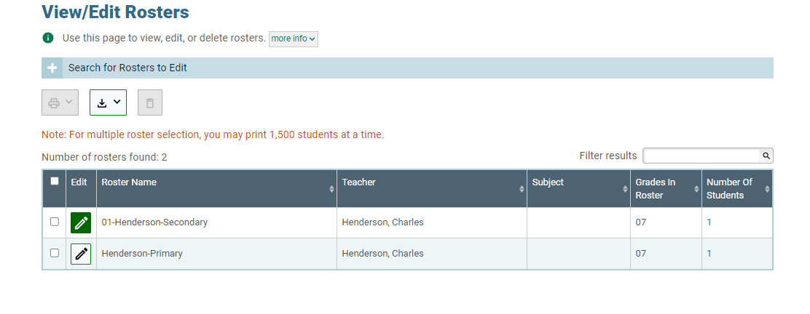
Editing Rosters
Still on the same screen, click the pencil icon.

Slide 28
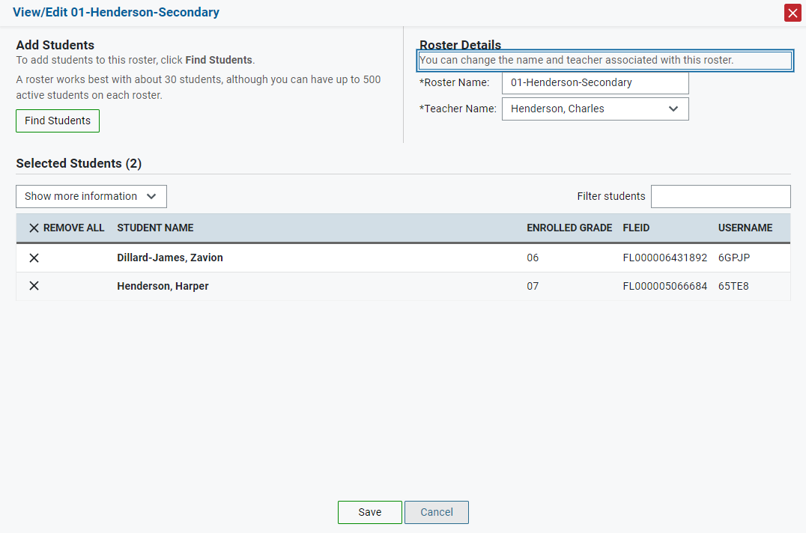
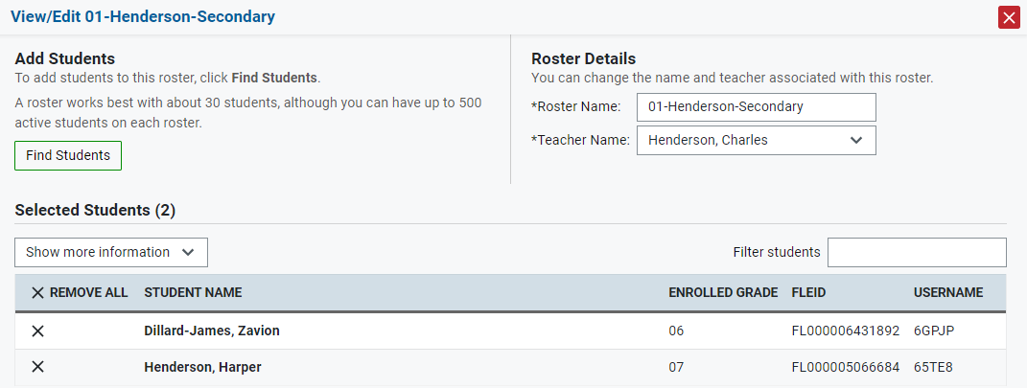
Student Search (to create or edit roster)
Change the name of a roster.
Assign it to a different teacher.

Slide 29
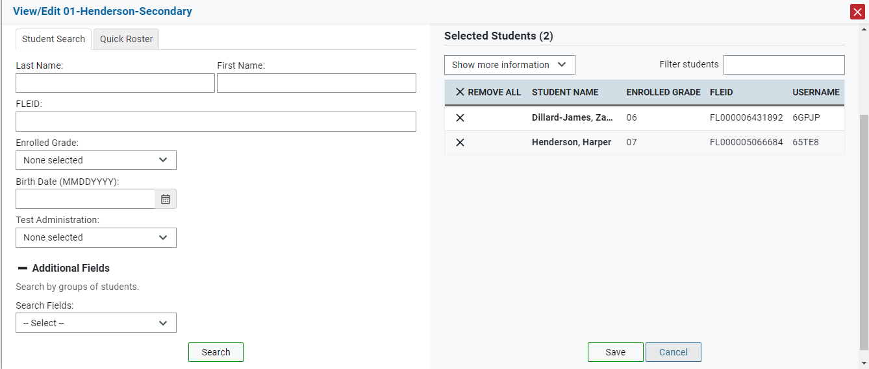
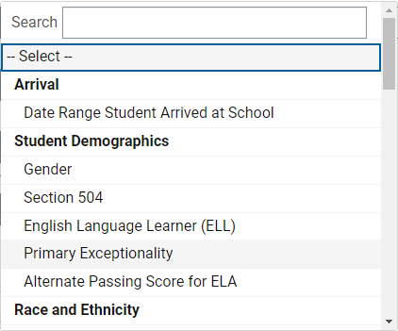
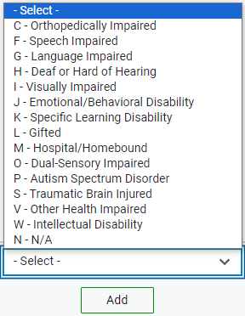
Student Search (to create or edit roster)

Slide 30
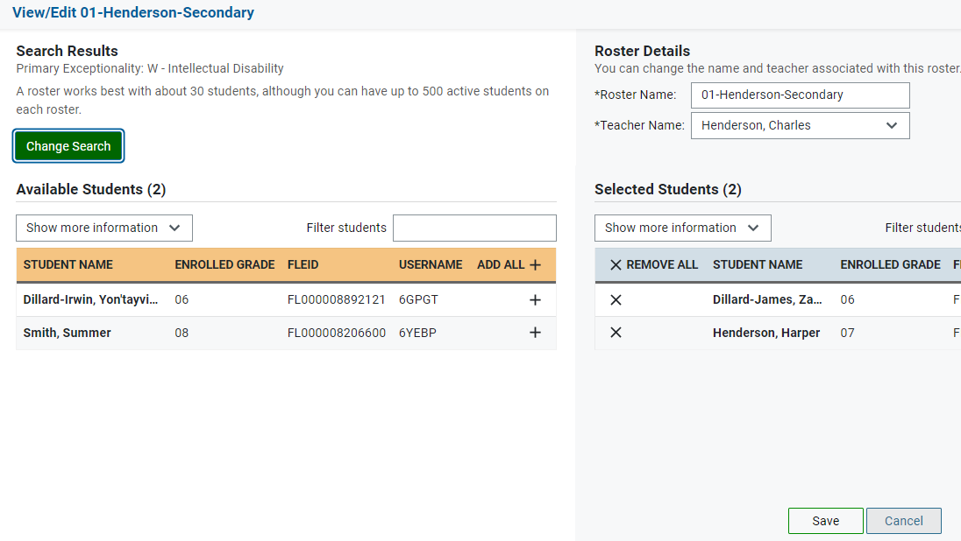
Student Search (to create or edit roster)

Slide 31
Recap: Creating, Editing, & Viewing
Access from TIDE or FRS
The same screen is used for almost all functions
Save after editing

Slide 32
Prior Year Data
TIDE data cannot be modified for the previous year
In FRS:
Prior test scores are available for current rosters
Current test scores are not available for prior rosters

Slide 33
Reminders
When in doubt, reference the TIDE User Guide https://flfast.org/teachers.html
Use rosters to create testing groups or view results
Double check the file upload template
Creating, editing, and viewing rosters uses the same search screen
Test results are only accessible by roster
Data is not pulled from Focus

Slide 34
Contacts
Charlie Henderson – CHenderson2@ecsdfl.us
Teacher uploads
Rosters
Scott Dodson – SDodson@ecsdfl.us
Student Pre-ID
850-469-5386

